Slide 1




Seminar on “ Google’ s Page Ranking Algorithm “
Avinash Singh
MTech [Mathematics and Computing]
Indian Institute of Technology Patna

Slide 2
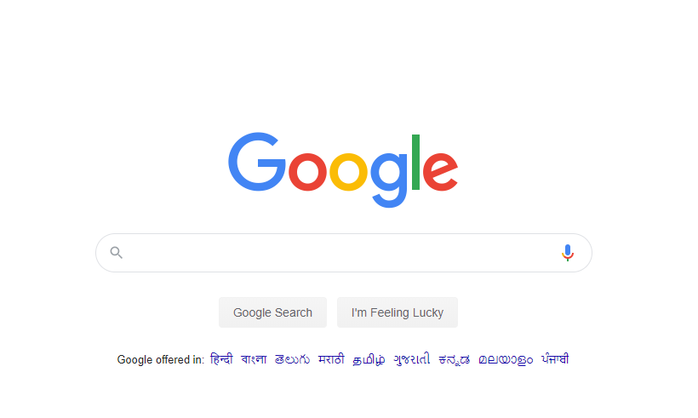


Slide 3
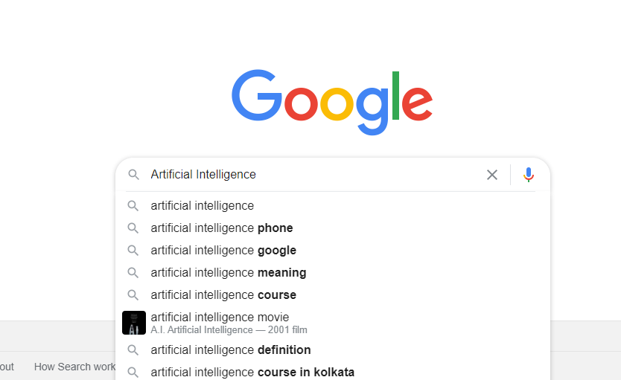

Slide 4



Slide 5
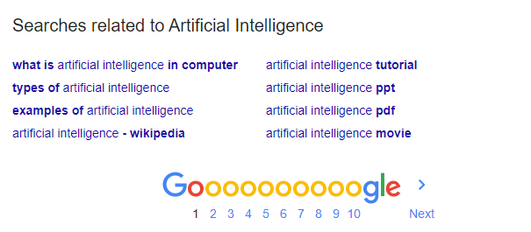
Rank 1
Rank 2
Decreasing order of Ranking
Rank 3
Numerous Pages
related to your
search exists

Slide 6
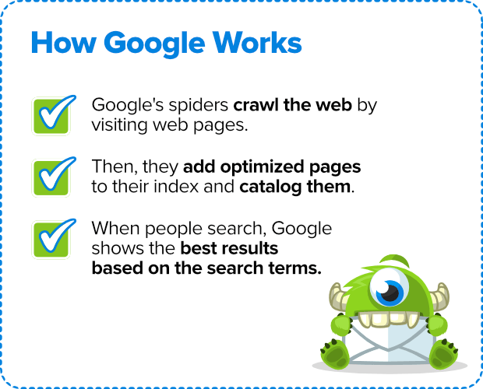
Our
Area of Interest for today

Slide 7

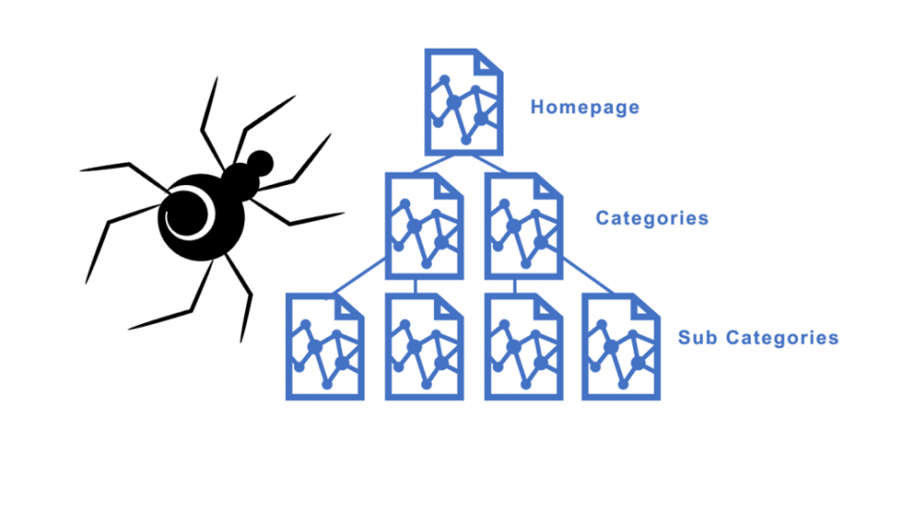

Google Spider is basically Google's crawler.
A crawler is an program/algorithm designed by search engines to crawl and track websites and web pages as a way of indexing the internet.
When Google visits your website for tracking/indexing purposes, this process is done by Google's Spider crawler.

Slide 8

Crawling
The first step is finding out what pages exist on the web.
There isn't a central registry of all web pages, so Google must constantly search for new pages and add them to its list of known pages.
Some pages are known because Google has already visited them before. Other pages are discovered when Google follows a link from a known page to a new page
Indexing
After a page is discovered, Google tries to understand what the page is about.
This process is called indexing.
Google analyzes the content of the page, catalogs images and video files embedded on the page, and otherwise tries to understand the page.
This information is stored in the Google index, a huge database stored in many, many (many!) computers.

Slide 9

Ranking
When a user types a query, Google tries to find the most relevant answer from its index based on many factors.
Google tries to determine the highest quality answers, and factor in other considerations that will provide the best user experience and most appropriate answer, by considering things such as the user's location, language, and device (desktop or phone)

Slide 10


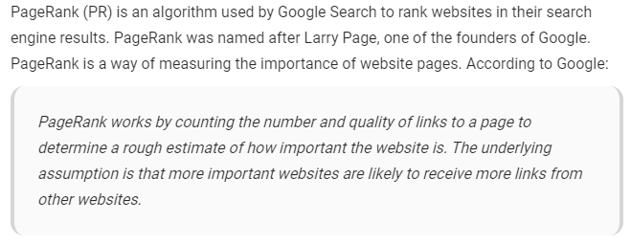
What is Page Ranking ?
<<Point to be NOTED >>

Slide 11
Let’s implement the WWW on a Graph
Page 1
Page 2
Page 4
Page 3
The WWW hyperlink structure forms a huge directed graph where the nodes
represent web pages.
Directed edges are the Hyperlinks

Slide 12
Inbound Links
Links into the given
website from other websites
Page 1
Outbound Links
Links from the given
Page to other page on same website or some other pages on the other websites
Page 1

Slide 13

Page Rank Formula
PR(A) – Page Rank of Page A
PR(Ti) - Page Rank of Pages Ti which link to page A
C(Ti) number of out bounds links on a given Ti page.
d – Damping Factor in the range 0 and 1
Initially Page Ranks of all the pages at the brginning are equal and = 1/n
~n is the number of pages

Slide 14
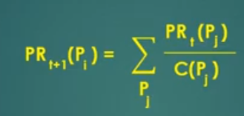
Iterative Formula
Pj are the websites pointing to the website Pi

Slide 15
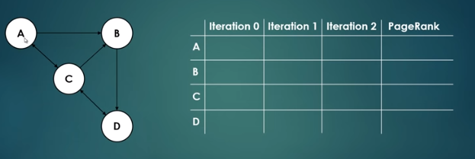
How it works?

Slide 16

Let’s use Probability !

Slide 17
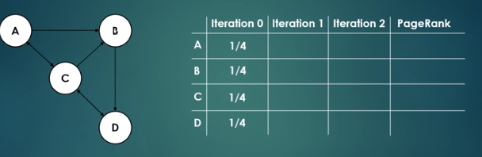
Initially !

Slide 18
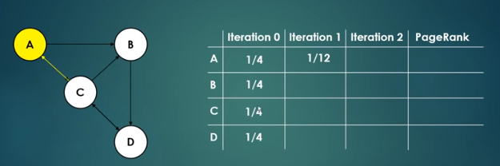
Proability of visiting each of the nodes in second click !
(i.e Iteration 1)
Suppose we want to find the Probability of visiting node A in second click.
For that Let’s see from which nodes we can visit node A.
Clearly Node A can be visited from Node C.
Now from C we have 3 paths to A,B,D.
So probability of choosing path to A = 1/3.
PR(A) = 1/4* 1/3 = 1/12 .

Slide 19
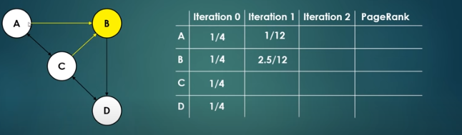
Suppose we want to find the Probability of visiting node B in second click.
For that Let’s see from which nodes we can visit node B.
Clearly Node B can be visited from Node C and A .
Now from C we have 3 paths to A,B,D.
So probability of choosing path CB = 1/3.
Now from A we have 2 paths to B and C.
So probability of choosing path AB = 1/2
PR(B) = 1/4* [ 1/3 + 1/2 ] = 5/24 = 2.5/12

Slide 20
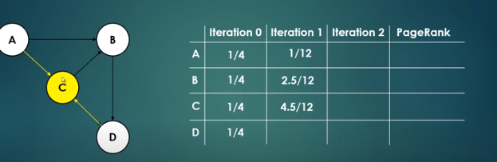
Suppose we want to find the Probability of visiting node C in second click.
For that Let’s see from which nodes we can visit node C.
Clearly Node C can be visited from Node D and A .
Now from D we have 1 paths to C .
So probability of choosing path DC = 1
Now from A we have 2 paths to B and C.
So probability of choosing path AC = 1/2
PR(B) = 1/4* [ 1 + 1/2 ] = 3/8 = 4.5/12

Slide 21
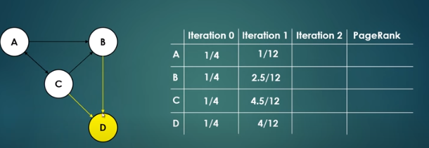
Suppose we want to find the Probability of visiting node D in second click.
For that Let’s see from which nodes we can visit node D.
Clearly Node D can be visited from Node B and C .
Now from B we have 1 paths to D.
So probability of choosing path BD = 1
Now from C we have 3 paths to B ,D and A.
So probability of choosing path CD = 1/3
PR(B) = 1/4* [ 1 + 1/3 ] = 1/3 = 4/12

Slide 22
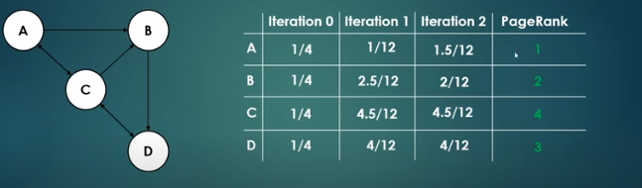
The process can be repated and finally we find the Rank!
4
3
1
2
1
1
1
Why Page D ranked 2 ? Even if it was not that important !

Slide 23

Page D was ranked 2 even if it was not that important because a very important page C was pointing to it.
So it means if we want a page to be ranked better an important page should point to it.
But Why So ??

Slide 24
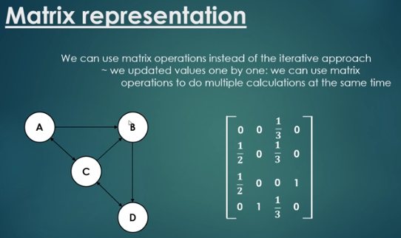
A
B
C
D
A
B
C
D

Slide 25
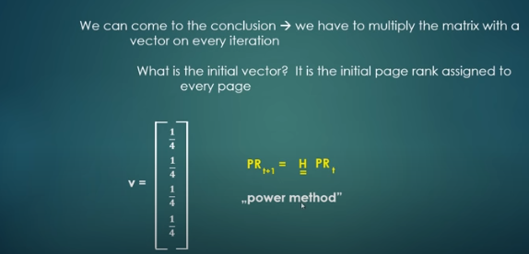

Slide 26
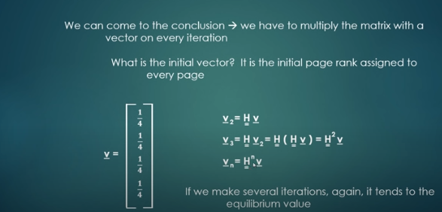
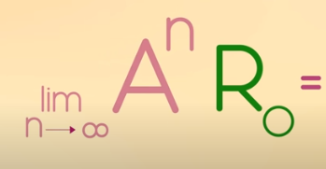


Slide 27
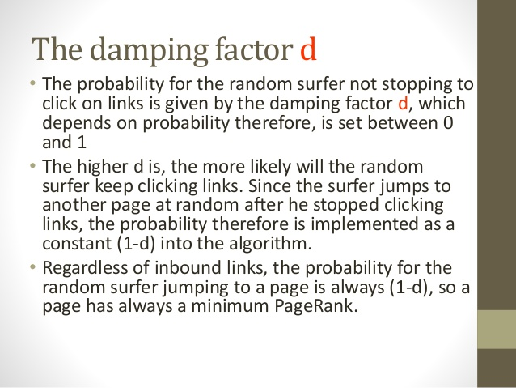
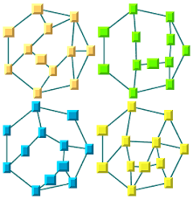
Do you remember the Damping factor we talked about earlier ?

Slide 28

Sources :
https://searchengineland.com/what-is-google-pagerank-a-guide-for-searchers-webmasters-11068
https://www.ganitcharcha.com/view-article-Mathematics-Behind-Google-Search-Engine---A-Brief-Note.html#:~:text=Google's%20PageRank%20algorithm%20has%20a,search%20for%20a%20query%20%2F%20keyword.&text=PageRank%20algorithm%20quantifies%20the%20importance,%2C%20%5Cldots%2C%20n).
https://www.link-assistant.com/news/google-page-rank-2019.html
Images : Zach Star, Global Software Support

